Slide 1
“R” Tutorial on Statistical Manipulation of DATA
by
Faizan Ali
Abdullah Rizvi
Ammar Ateeq
Rahul Mondal

Slide 2
Contents
“R” Programming
An Introduction [ slides 5 - 6 ]
Installing R [ slides 7 - 10 ]
Packages [ slides 11 & 12 ]
Data Types in “R” and their modes : Vector, Factor, Array, Matrix, Data Frame, TS (Time Series), List [ slides 14 - 22 ]
Reading Data in “R” : Input, Output [ slides 24 -26 ]
Packages
tidyr : gather(), spread(), unite(), separate() [ slides 28 - 39 ]
ggplot2 : geom_point(), geom_text(), geom_smooth(), stat_smooth() [slides 41 - 51 ]

Slide 3
After this Tutorial, you should be able to
Have a basic understanding of “R”
Install the proper & latest package of “R” on your system and run your first script
Understand the data types used in “R”
Understand packages used in “R” to manipulate your data for pre-processing and post-processing

Slide 4
R Programming
Intro, why and Packages

Slide 5
What is R?
R is a programming language developed by Ross Ihaka and Robert Gentleman in 1993.
R possesses an extensive catalog of statistical and graphical methods.
It compiles and runs on a wide variety of UNIX platforms, Windows and MacOS.
What is R used for?
Statistical inference
Numerical simulation
Data analysis
Data Visualization
Machine learning algorithm

Slide 6
Why Learn R?
Open-source Language
Cross-platform compatible
Advanced Statistical Language
Outstanding Graphs
Big Community!
Extremely Comprehensive Flexible & Fun!

Slide 7
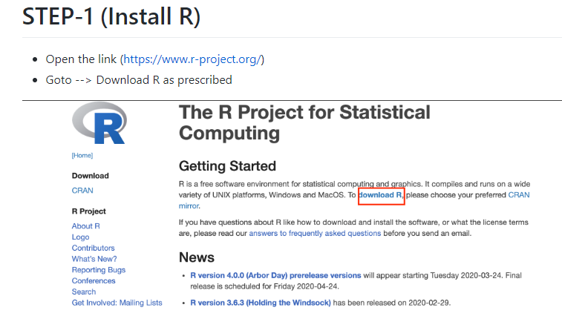
Installing R

Slide 8
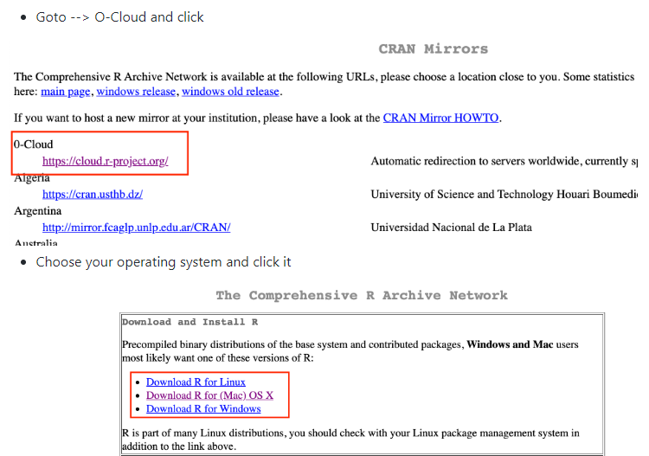
Installing R

Slide 9
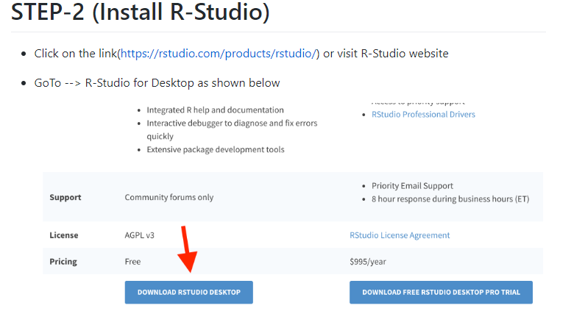
Installing R

Slide 10
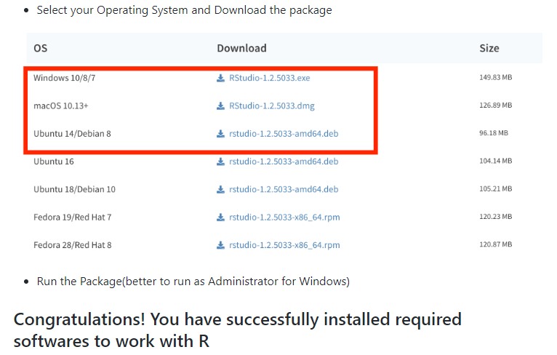
Installing R

Slide 11
R Packages
Many useful R functions come in packages
They increase the power of R by improving existing base R functionalities
They bundle together code, data, documentation, and tests
There are thousands of packages available on the Comprehensive R Archive Network, or CRAN
Commonly used R Packages are:
Dplyr, tidyr, ggplot2, shiny etc.

Slide 12
R Packages
To install an R package, type following in the command line:
After it is installed, you can make its contents available by running:
You can also get help on them by help(package =“<the package’s name>”)
R will download the package from CRAN

Slide 13
????

Slide 14
DATA TYPES IN R?
There are several Data types depending upon the nature of work one has do. Following is a list in which you can store data.
Vector
Factor
Array
Matrix
Data Frame
TS
List

Slide 15
Vector
Contains a sequence of items of the same type. This is most basic structure, e.g. x <- 10 or name <- ‘Harry’

Slide 16
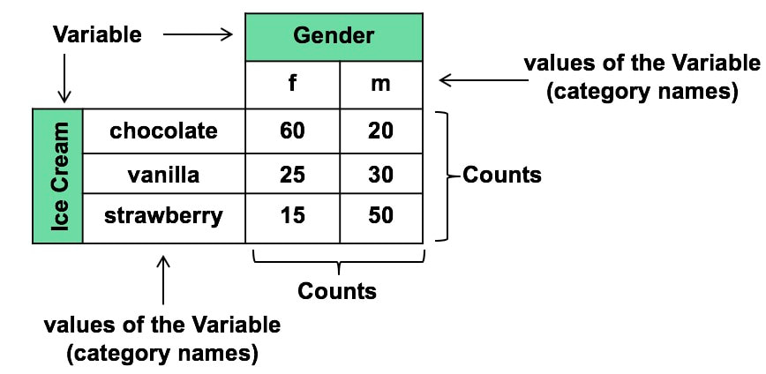
Factor
A Factor is a Categorical Variable.
A Categorical variable represents types of attributes. e.g. Gender: Male, Female or Flavors of ice cream: Chocolate, Vanilla, Strawberry.

Slide 17
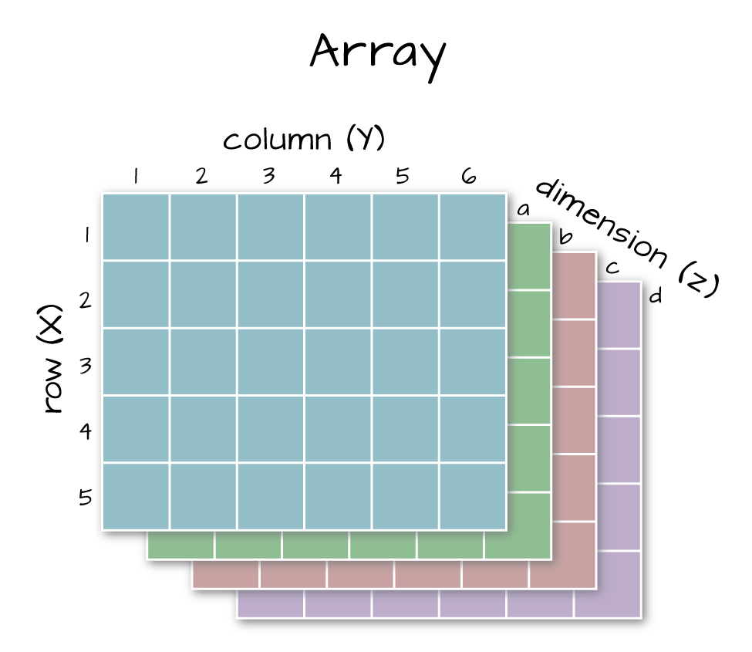
Array
An Array is a table with ‘k’ dimensions. Usually used to store data in a table format. If we create an array of dimensions (2,3,4) then 4 rectangular matrices will be created, each with 2 rows and 3 columns.

Slide 18
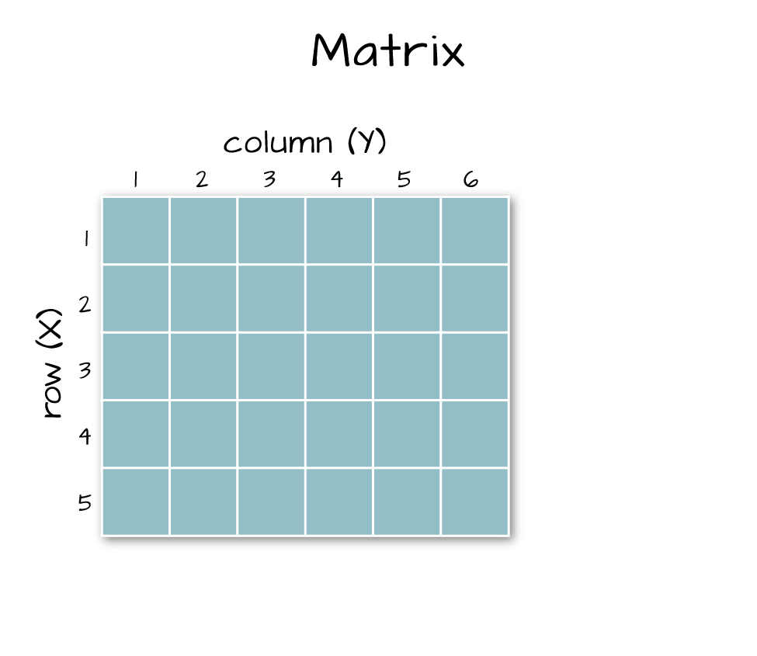
Matrix
A Matrix is an Array, but having specifically two dimensions, e.g. ‘k=2’.

Slide 19
Data Frame
A data frame is a table composed with one or several vectors and/or factors all of the same length but possibly of different modes. A data frame may contain multiple arrays.

Slide 20
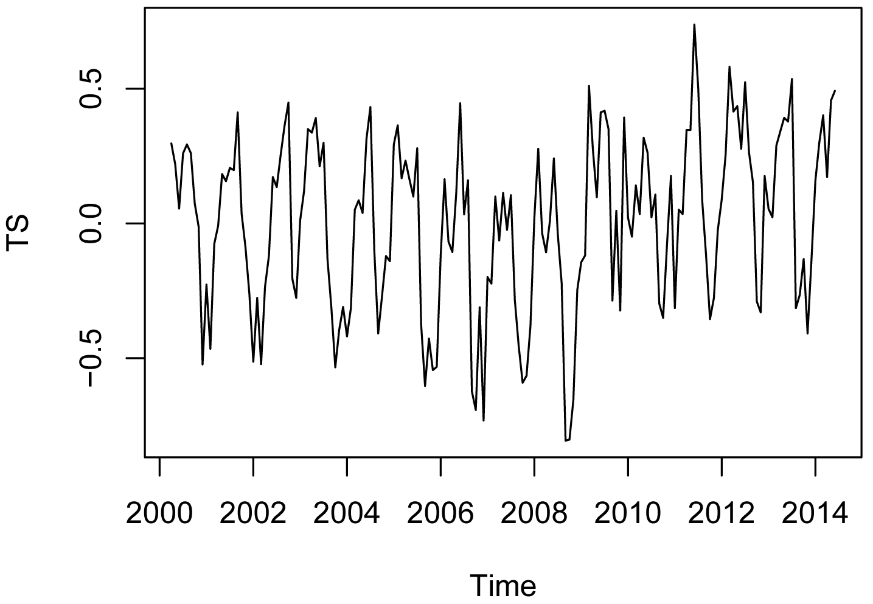
TS – Time Series
A TS is a Time Series dataset, additionally it contains attributes like frequency and dates.

Slide 21
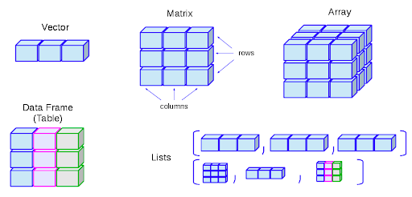
List
A list is the ultimate data type to store every element, including vectors, factors, data frames and even list itself.

Slide 22
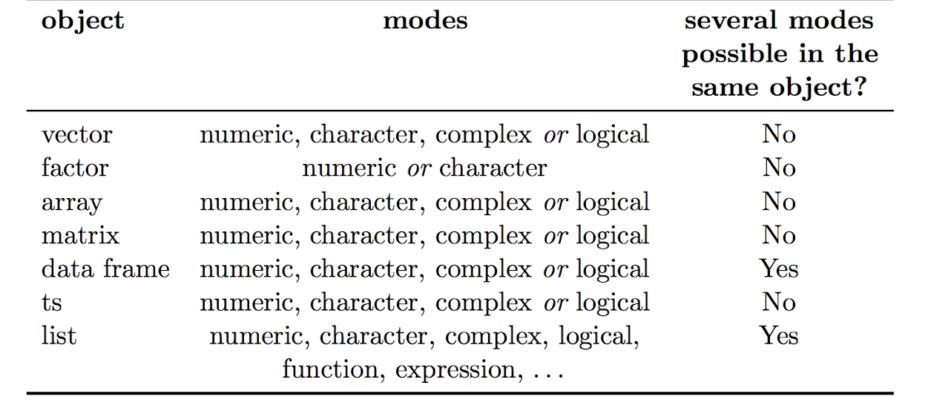
Data Types and Their Modes

Slide 23
READING DATA IN R

Slide 24
INPUT
The input format is quite easy. We just have to know the path of the file.
df <- read.csv("C:/Desktop/airquality.csv")
“header = True” in read.csv is a logical value, indicating whether the file contains the names of the variables in the first line.

Slide 25
OUTPUT
write.csv(Your DataFrame,"Path where you'd like to export the Data Frame \\File Name.csv", row.names = FALSE)
Formally: write.csv(df,"C:\\Users\\Ron\\Desktop\\MyData.csv", row.names = FALSE)
row.names is used to name the first column of the dataset. It defines the name of rows.

Slide 26
QUICK TASK
Download the data from here: (https://drive.google.com/open?id=1I1pKFcObgkGoHtm6twRYoqC4-aJLMUts)
Input the dataset via R command.
Output the dataset via R command.

Slide 27
????

Slide 28
Handle Tidy Data

Slide 29
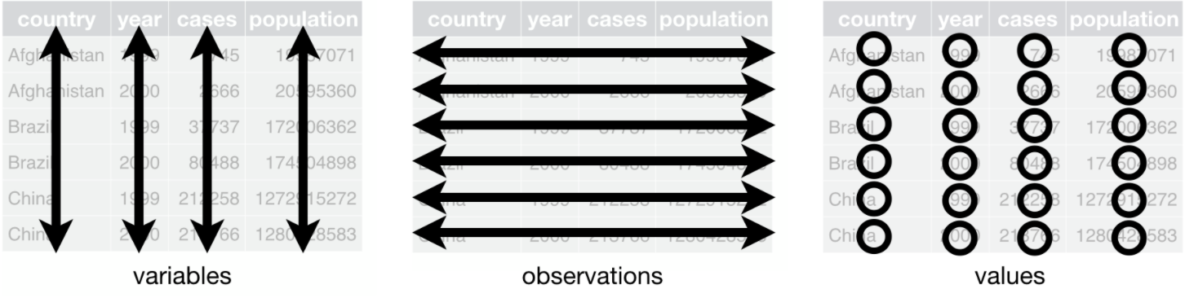
What is Tidy Data?
A data set is called tidy when:
each column represents a variable
and each row represents an observation
The opposite of tidy is messy data, which corresponds to any other arrangement of the data.

Slide 30
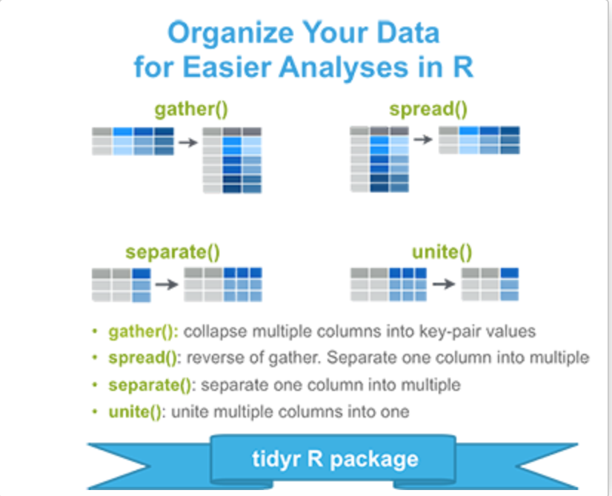
Package to Manipulate Tidy-Data? (Tidyr)
Organize (or reshape) your data in order to make the analysis easier. This process is called tidying your data.
gather(): gather (collapse) columns into rows
spread(): spread rows into columns.
separate(): separate one column into multiple
unite(): unite multiple columns into one

Slide 31
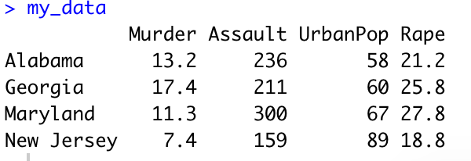
Hands-on Tidyr:
# Installing
install.packages("tidyr")
# Loading
library("tidyr")
# Load-Dataset
my-data <- USArrests[c(1, 10, 20, 30), ] # [c(1,10,20,30), ] means specific rows and all columns

Slide 32
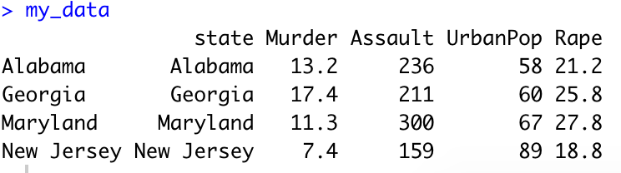
# Row names are states, so let’s use the function cbind() to add a column named “state”
# In the data. This will make the data tidy and the analysis easier.
My_data <- cbind(state = rownames(my_data), my_data)
my_data
States as a columns

Slide 33
gather(): collapse columns into rows [Replacement of MELT(reshape2)]
Simplified format:
gather(data, key, value, ...)
data: A data frame
key: Names of key
value: Value columns to create in output
…: Specification of columns to gather.
Allowed values are: variable names
if you want to select all variables between a and e, use a:e
if you want to exclude a column name y use -y
for more options, see: dplyr::select()

Slide 34
Usage of gather():
https://drive.google.com/file/d/1N0AZZtf7IaZKCRm2Vuj0u8vcLeQ1tlim/view?usp=sharing
Move to tidy.R file

Slide 35
spread(): spread two columns into multiple columns [Replacement of CAST(reshape2)]
Features:
The function spread() does the reverse of gather().
It takes two columns (key and value) and Spreads into multiple columns. It produces a “wide” data format from a “long” one.
Simplified format:
gather(data, key, value, ...)
data: A data frame
key: The (unquoted) name of the column whose values will be used as column headings value: The (unquoted) names of the column whose values will populate the cells

Slide 36
Usage of spread()
Move to tidy.R file

Slide 37
unite(): Unite multiple columns into one
The function unite() takes multiple columns and paste them together into one.
Simplified format:
unite(data, col, ..., sep = "_")
data: A data frame
col: The new (unquoted) name of column to add.
sep: Separator to use between values

Slide 38
separate(): separate one column into multiple
The function sperate() is the reverse of unite(). It takes values inside a single character
column and separates them into multiple columns.
Simplified format:
separate(data, col, into, sep = "[^[:alnum:]]+")
data: A data frame
col: Unquoted column names
into: Character vector specifying the names of new variables to be created.
sep: Separator between columns:

Slide 39
Usage of unite() & separate()
Move to tidy.R file

Slide 40
Practice Task

Slide 41
Visualize Your Data
ggplot2 is a powerful and a flexible R package, used for producing elegant graphics.
The concept behind ggplot2 divides plot into three different fundamental parts: Plot = data + Aesthetics + Geometry.
The principal components of every plot can be defined as follow:
data is a data frame
Aesthetics is used to indicate x and y variables. It can also be used to control the color, the size or the shape of points, the height of bars, etc…..
Geometry defines the type of graphics (histogram, box plot, line plot, density plot, dot plot, ….)

Slide 42
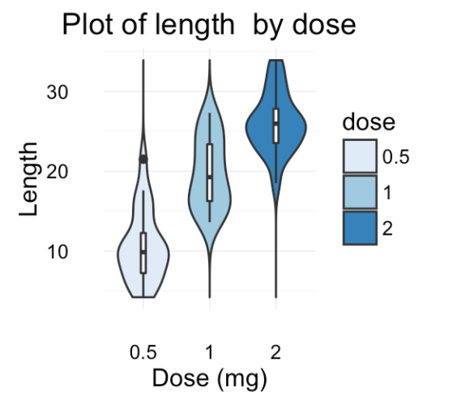
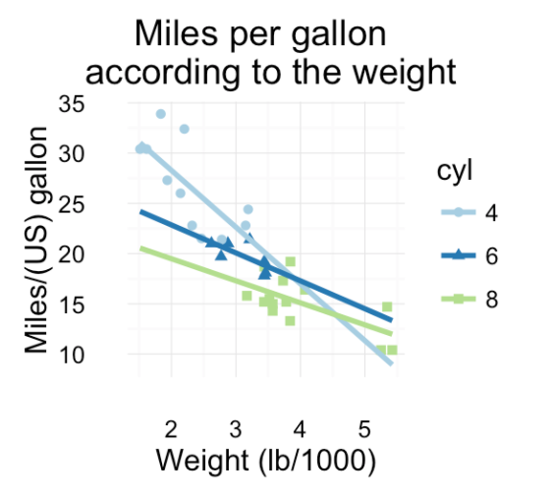
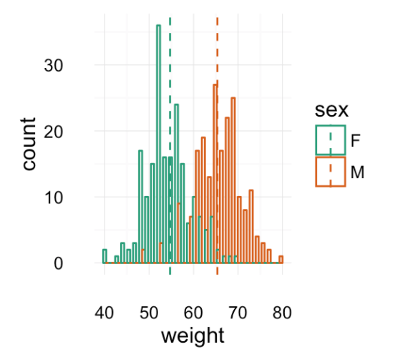
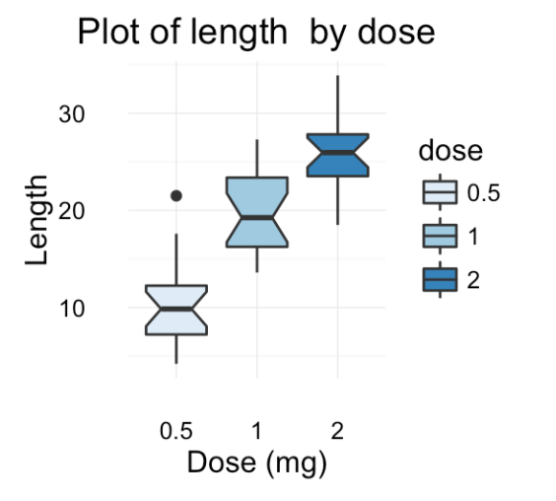
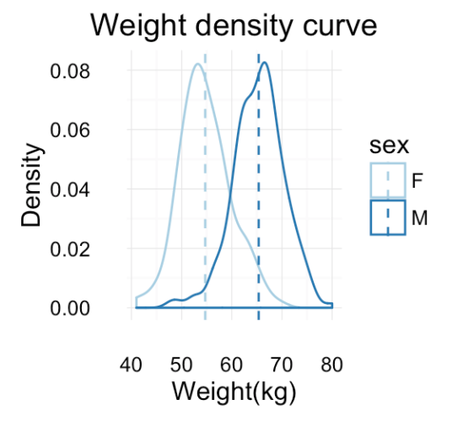
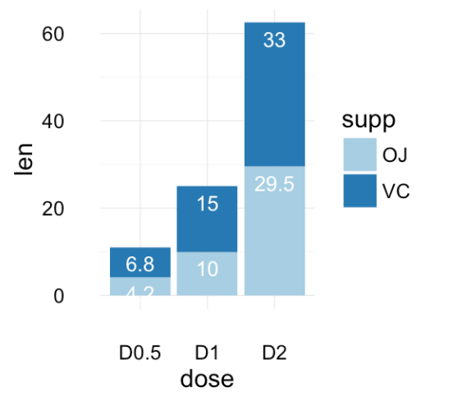

Slide 43
Scatter-Plots using ggplot2()
Basic scatter plots
Simple scatter plots are created using the R code. The color, the size and the shape of points can be changed using the function geom_point() as follow :
geom_point(size, color, shape)

Slide 44
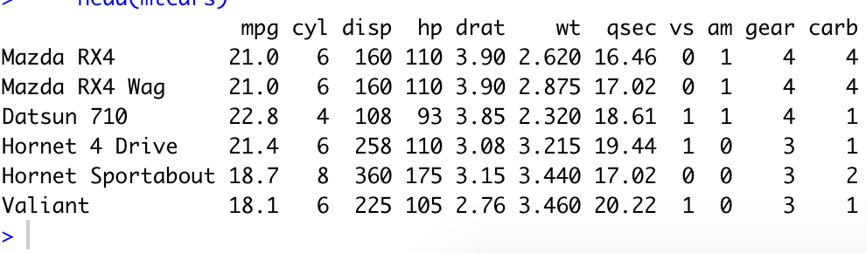
Install Package ggplot2() and data-set
Package:
install.packages(‘ggplot2’)
Library(ggplot2)
Data-Set:
mtcars

Slide 45
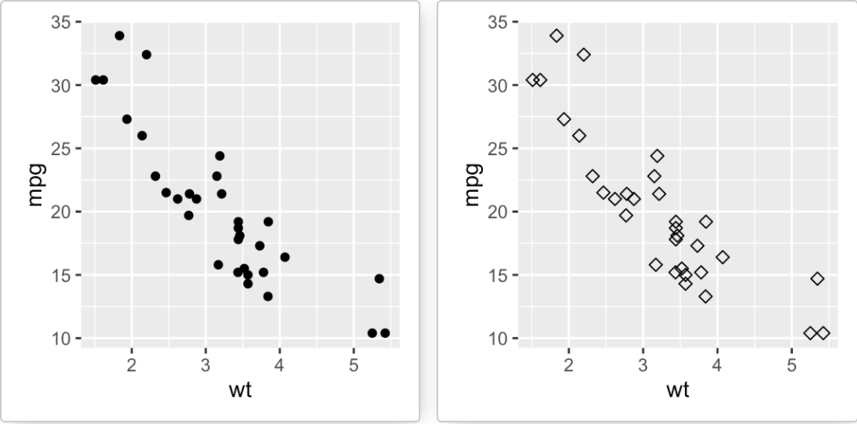
library(ggplot2)
# Basic scatter plot:
ggplot(mtcars, aes(x=wt, y=mpg)) + geom_point()
# Change the point size, and shape:
ggplot(mtcars, aes(x=wt, y=mpg))
+ geom_point(size=2, shape=23)

Slide 46
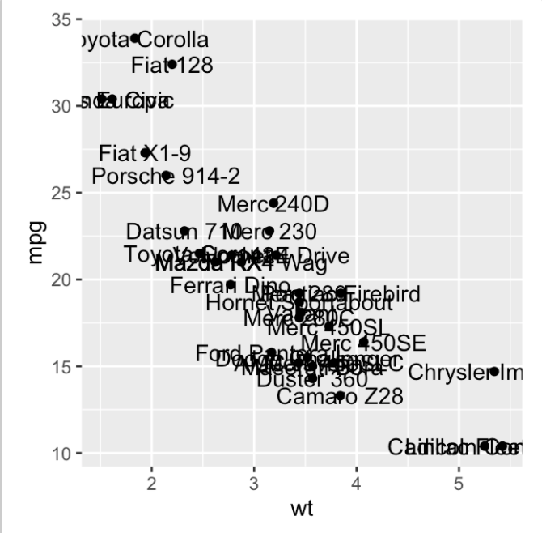
Label points in the scatter plot
The function geom_text() can be used:
ggplot(mtcars, aes(x=wt, y=mpg)) +geom_point() + geom_text(label=rownames(mtcars))

Slide 47
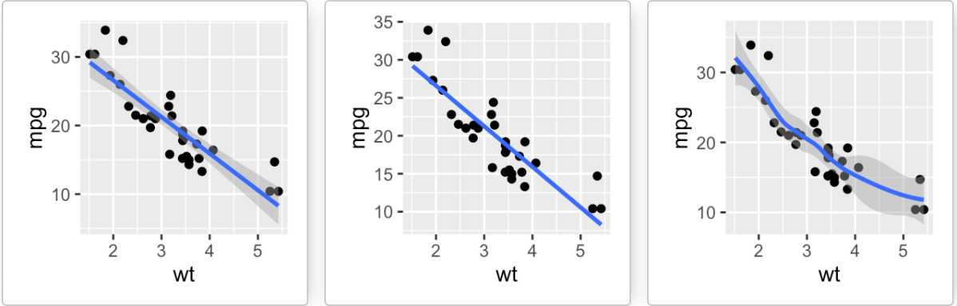
Add regression lines
The functions below can be used to add regression lines to a scatter plot :
geom_smooth() and stat_smooth()
.# Add the regression line:
ggplot(mtcars, aes(x=wt, y=mpg)) + geom_point()+ geom_smooth(method=lm)
# Remove the confidence interval:
ggplot(mtcars, aes(x=wt, y=mpg)) + geom_point()+ geom_smooth(method=lm, se=FALSE)
# Loess method:
ggplot(mtcars, aes(x=wt, y=mpg)) + geom_point()+ geom_smooth()

Slide 48
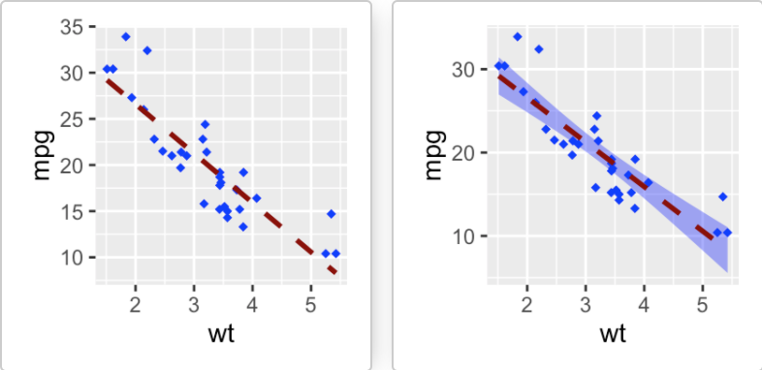
Change the appearance of points and lines
This section describes how to change :
the color and the shape of points
the line type and color of the regression line
the fill color of the confidence interval(se)
# Change colors and shape of point and line
ggplot(mtcars, aes(x=wt, y=mpg)) + geom_point(shape=18, color="blue")+ geom_smooth(method=lm, se=FALSE, linetype="dashed", color="darkred")
# Change the confidence interval fill color
ggplot(mtcars, aes(x=wt, y=mpg)) + geom_point(shape=18, color="blue")+ geom_smooth(method=lm, linetype="dashed", color="darkred", fill="blue")

Slide 49
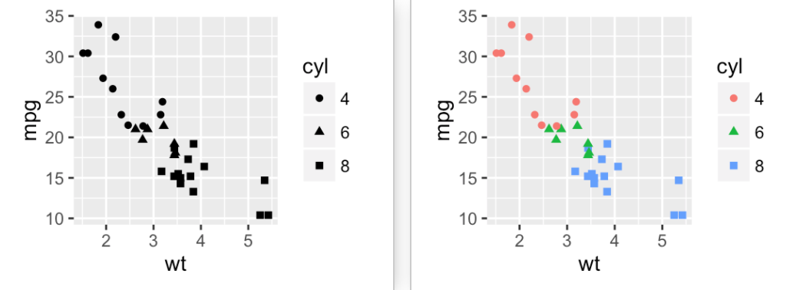
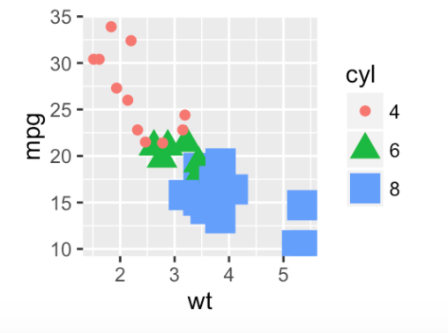
Scatter plots with multiple groups
Change the point color/shape/size automatically:
In the R code below, point shapes, colors and sizes are controlled by the levels of the factor variable cyl :
# Change point shapes by the levels of cyl ggplot(mtcars, aes(x=wt, y=mpg, shape=cyl)) + geom_point()
# Change point shapes and colors
ggplot(mtcars, aes(x=wt, y=mpg, shape=cyl, color=cyl)) + geom_point()
# Change point shapes, colors and sizes ggplot(mtcars, aes(x=wt, y=mpg, shape=cyl, color=cyl, size=cyl)) + geom_point()

Slide 50
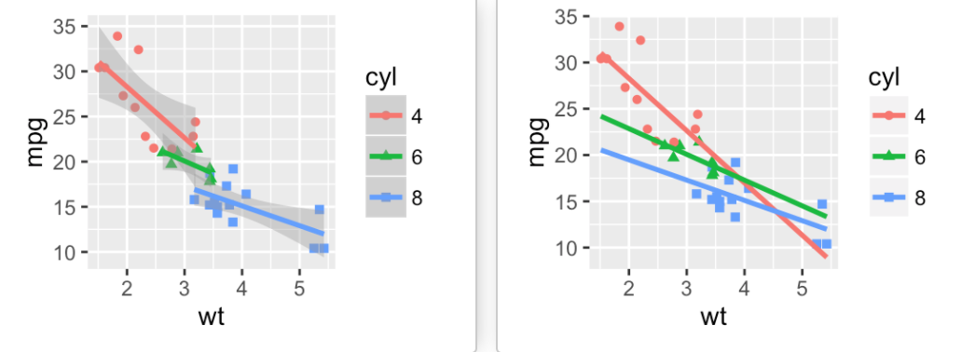
Add regression lines
# Add regression lines
ggplot(mtcars, aes(x=wt, y=mpg, color=cyl, shape=cyl)) + geom_point() + geom_smooth(method=lm)
# Remove confidence intervals and Extend the regression lines
ggplot(mtcars, aes(x=wt, y=mpg, color=cyl, shape=cyl)) + geom_point() + geom_smooth(method=lm, se=FALSE, fullrange=TRUE)

Slide 51
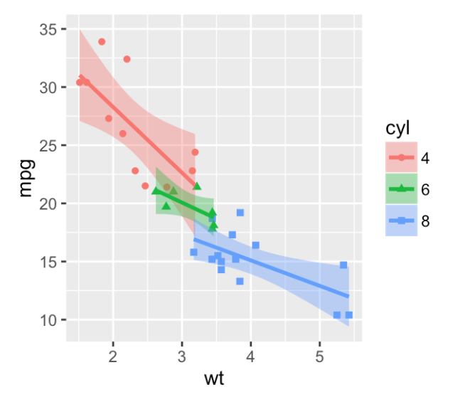
#The fill color of confidence bands can be changed as follow :
ggplot(mtcars, aes(x=wt, y=mpg, color=cyl, shape=cyl))
+ geom_point() + geom_smooth(method=lm, aes(fill=cyl))

Slide 52
????

Slide 53
Practice Task

